Slide 1
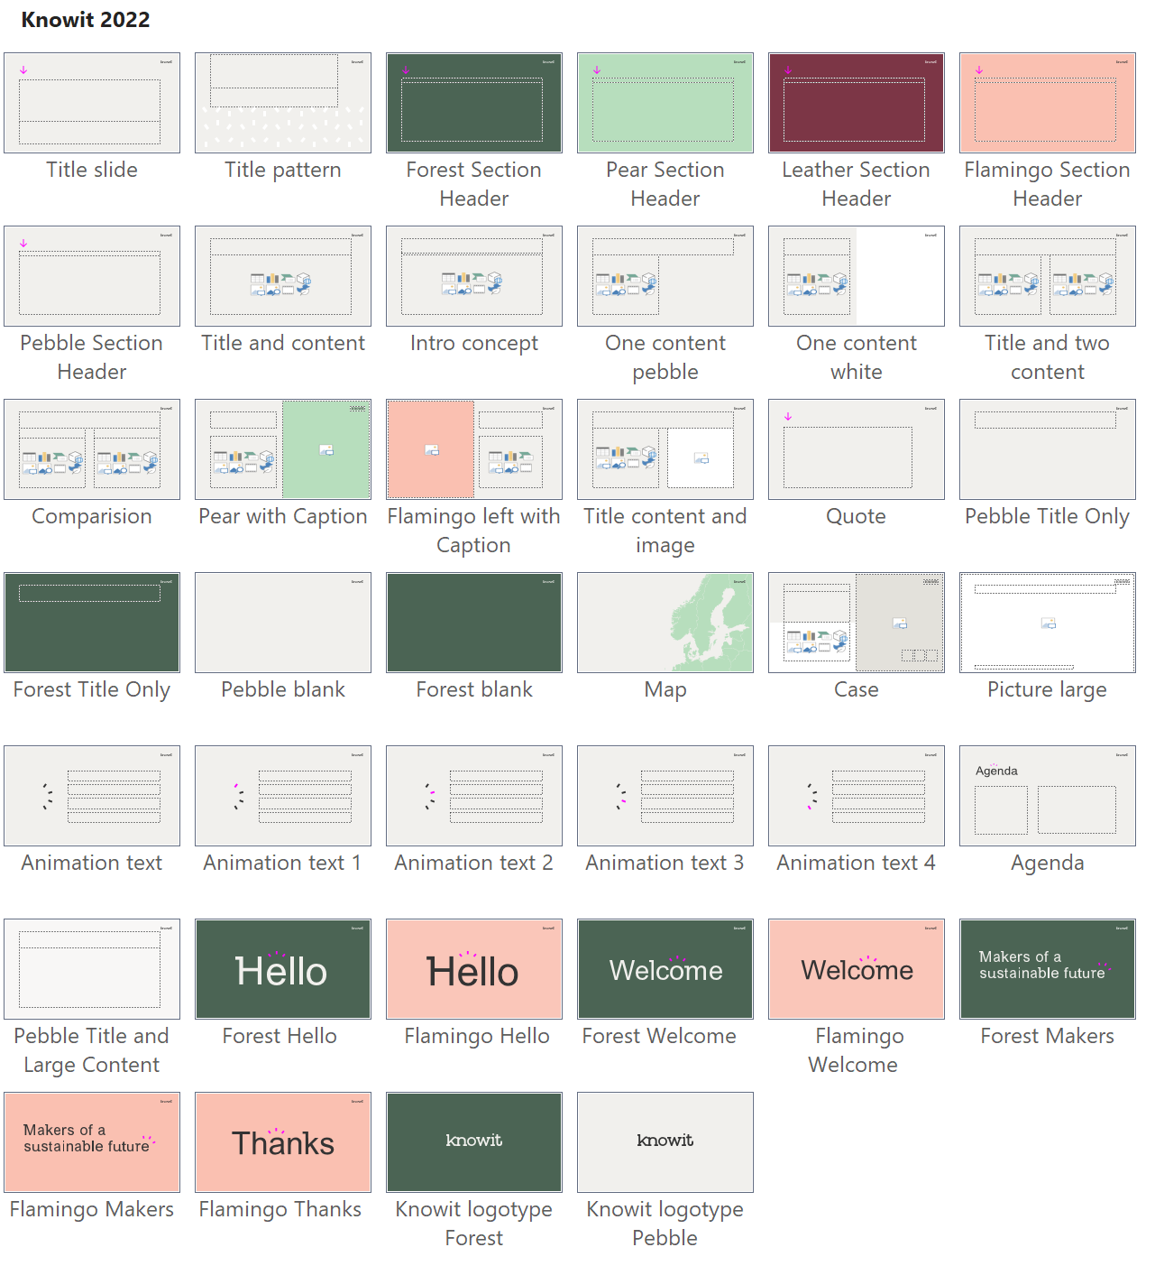
/ The template “Knowit 2022” contains 40 different layouts. Always use the best suitable layout for your content.
/ The PowerPoint template is the framework for your presentation, an exciting presentation is created using visuals content to support your story.
! Tip: Most layouts contain user guiding in the right margin
and a complete Knowit colour chart in the top margin.
! Also check out our brand book before you start creating your presentation: knowit.eu/brandbook

Slide 3

Hands on with Github Copilot
Tested in Visual Studio Code with Javascript, Typescript, Node.js, Flutter/Dart since October 2023 (~2 months)

Slide 4

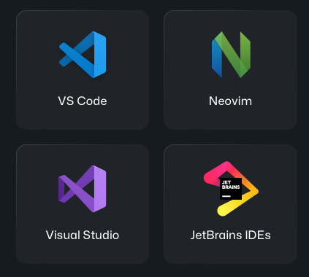
What is Github Copilot?
AI coding companion
First launched in October 2021 as a JetBrains plugin
Only available to all developers since June 2023
Powered by GPT-4
Works in Terminal and in IDEs:

Slide 5

Pricing
One month free trial
Copilot Individual: $10/month
Copilot Business: $19/user/month
Copilot Enterprise: $39/user/month

Slide 6
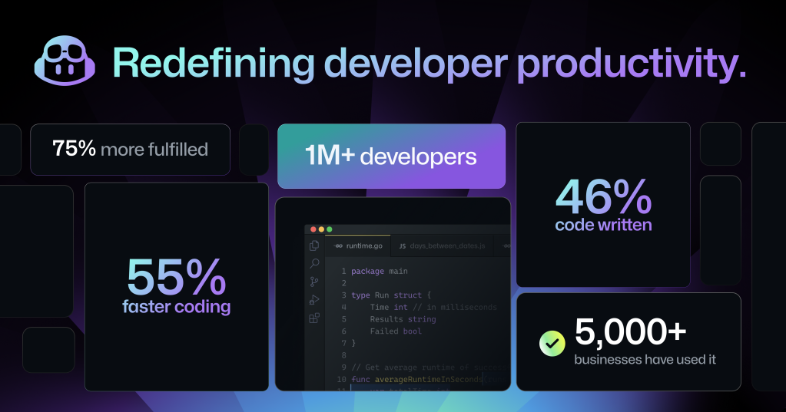


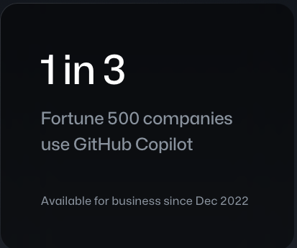
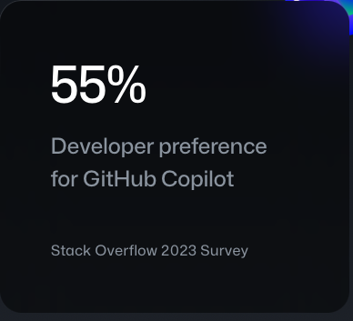
Is it as good as they claim it to be?

Slide 7
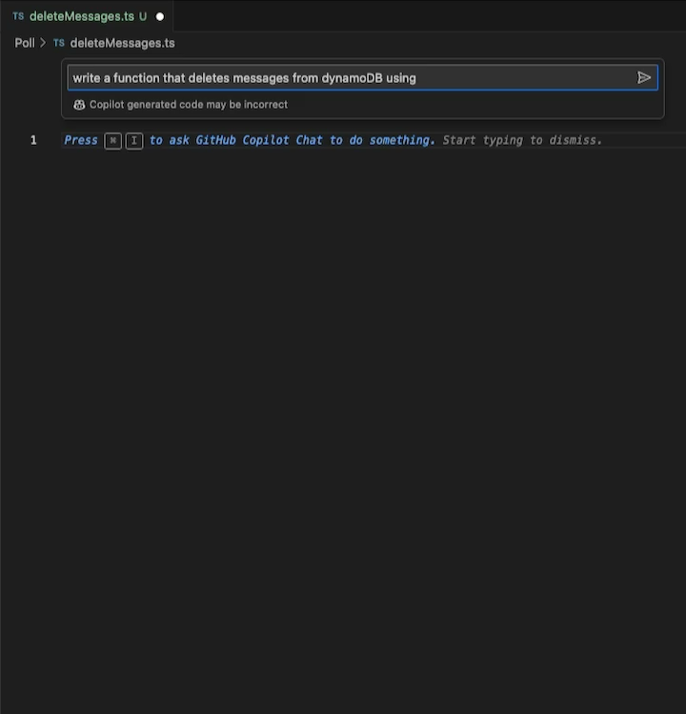
Example 1: write function from scratch
Lunch poll bot app using typescript/Deno
Empty file
Cmd I on Mac / Ctrl I on Windows
Prompt: “Write a function that deletes messages from DynamoDB using Deno”
Result: Quite good! ⭐️⭐️⭐️⭐️

Slide 8
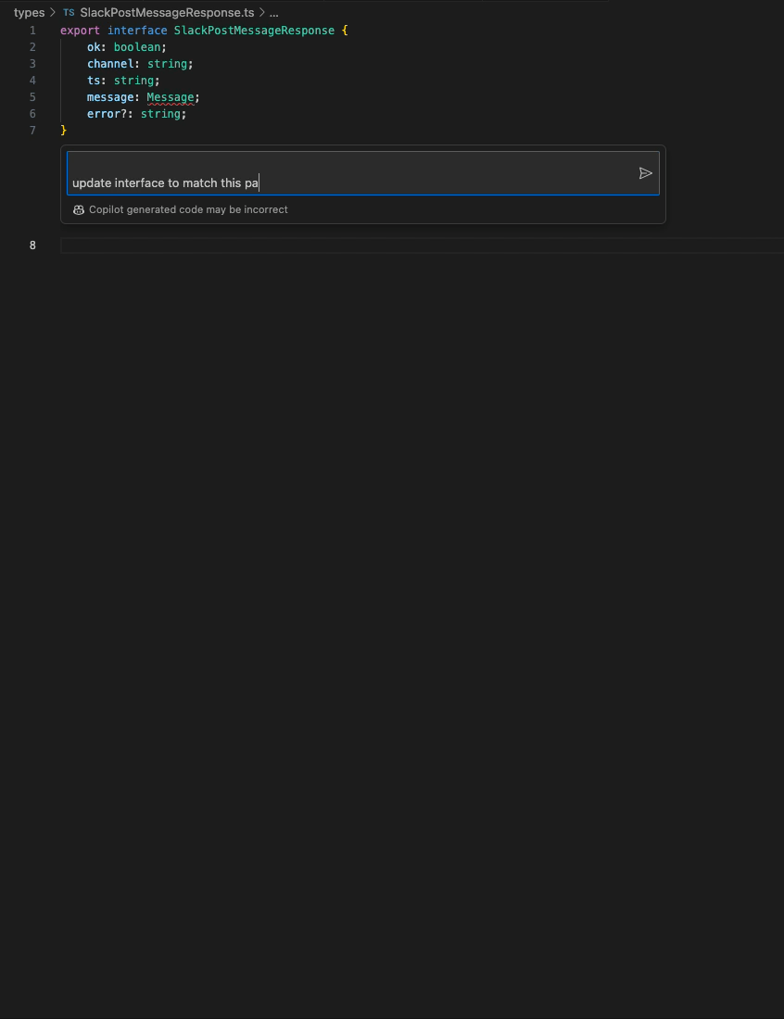
Example 2: Typescript interface from JSON
Create a Typescript interface from a Slack message JSON payload (captured with ngrok)
Prompt: ”Update interface to match this payload… (insert huge JSON file)”
Result: Remarkable ⭐️⭐️⭐️⭐️⭐️

Slide 9
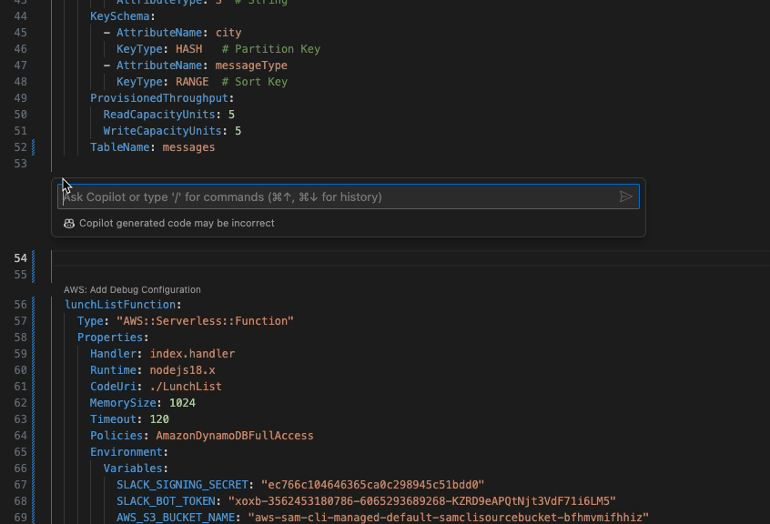
Example 3: AWS template: S3
AWS Cloud Formation / SAM (Serverless Application Model) YAML Template
Prompt: ”Create S3 Bucket to store lunch list images”
Result: Excellent ⭐️⭐️⭐️⭐️⭐️
Fast
Good naming
Works!

Slide 10
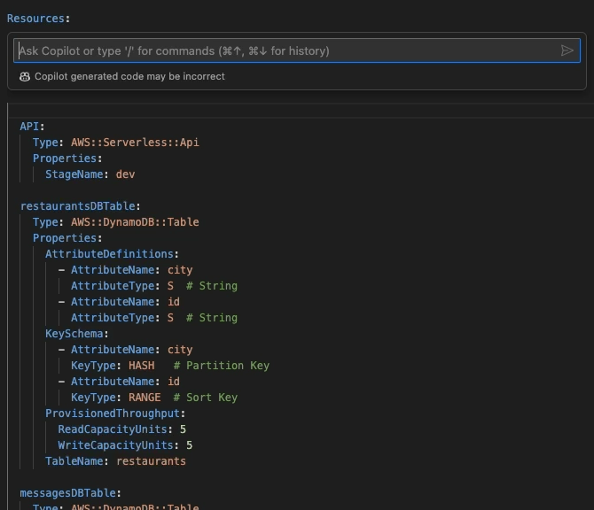
Example 4: AWS template: IAM role
AWS Cloud Formation / SAM (Serverless Application Model) YAML Template
Prompt: ”Create a reusable role to access a secret in AWS Secret manager that will be used by many functions”
Result: Excellent ⭐️⭐️⭐️⭐️⭐️
Fast
Good naming
Works!

Slide 11
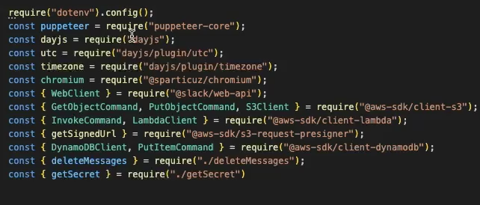
Example 5: Node. Convert “require” to “import”
Node.js Convert “require” to “import”
Select all lines.
Cmd i / Ctrl i
Prompt: ”Convert to import”
Result: Huge time saver ⭐️⭐️⭐️⭐️⭐️
Fast
Saves doing boring work
Works!

Slide 12
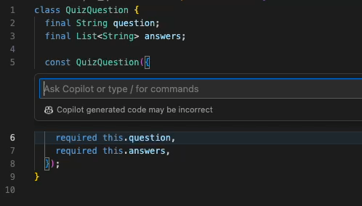
Example 6: Often leaves the old lines of code
Prompt: ”refactor to positional arguments”
Works ⭐️⭐️⭐️
BUT: doesn’t remove old lines
This is VERY FREQUENT unfortunately

Slide 13
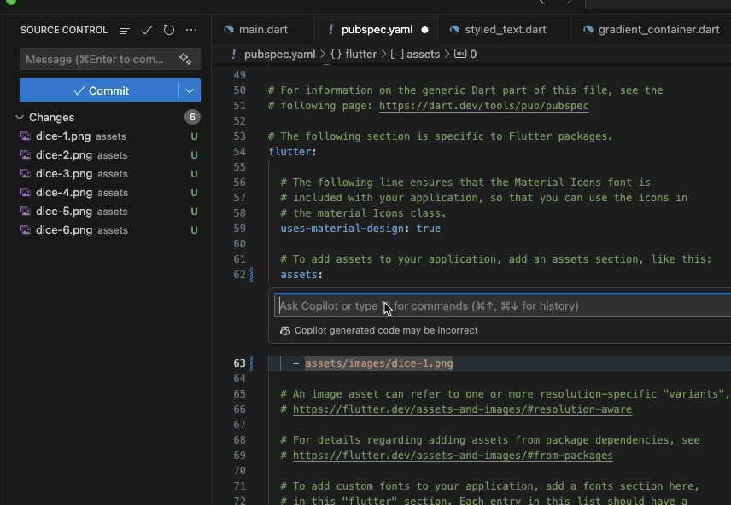
Example 7
Duplicate lines incrementally
YAML file/assets
Repetitive image names -1 to -6
Prompt: ”Duplicate 6 times until dice-6.png
Result: Excellent ⭐️⭐️⭐️⭐️⭐️

Slide 14
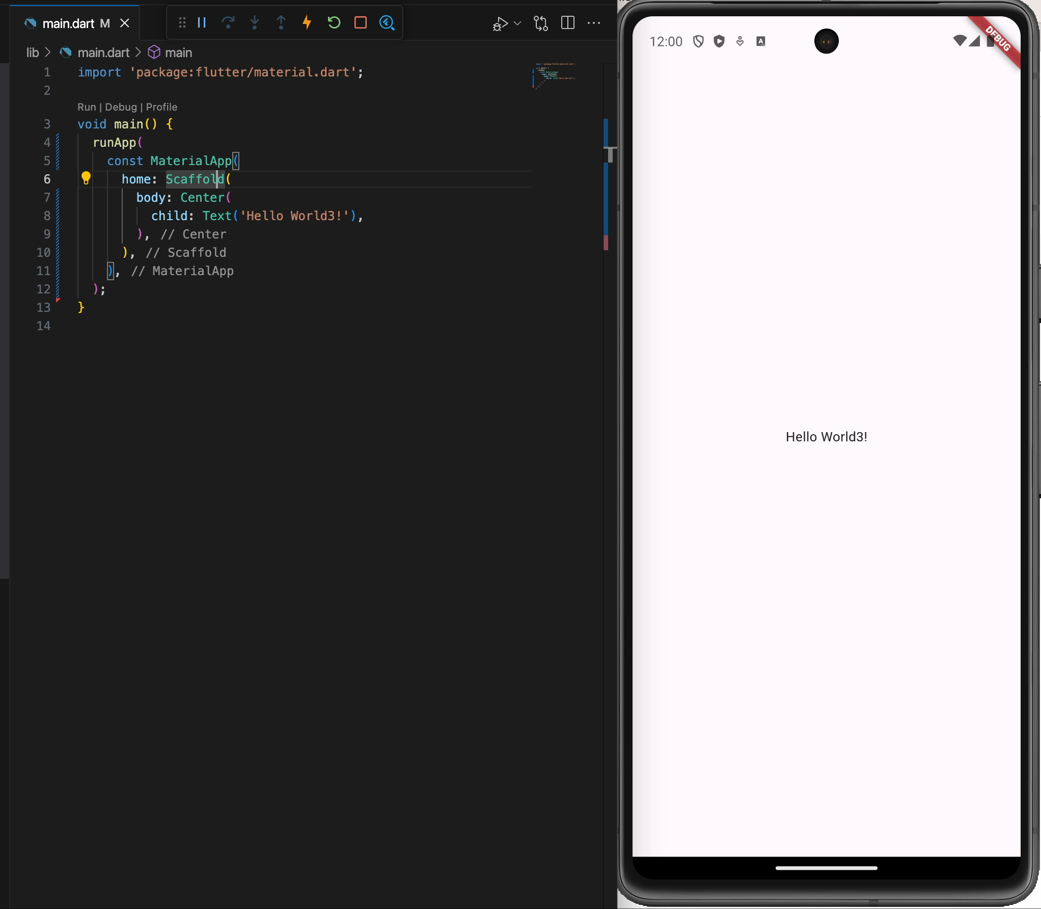
Example 8: Flutter
Flutter/Dart mobile app basics
Explore new technology
Prompts:
make background purple
make text bigger
make text yellow and even bigger
Result: Excellent ⭐️⭐️⭐️⭐️⭐️

Slide 15
Downsides
Often leaves the old code that mixes with new code.
BUT: that could be useful to have a better overview of what have changed.
Do not use it to write secrets and configs. It will autocomplete the wrong values 🙃
Need to investigate privacy and legal issues, like all AI tools.
Can make you lazy 🥱

Slide 16
My impression so far
Very easy to use. Works ”out of the box”
I would say: 1-2 days of using it pays for the license in time efficiency
Fun. Nice to experiment with.
Surprise effect: “Oh, I didn’t know you could do that.”
Nice for experimenting with new technologies.
Great for boring tasks
Replace require by import in x lines
Convert JSON to YAML
Doesn’t always work, but that’s OK *makes me feel useful 😎
It will probably get better!

Slide 17
Interested to try?
Instructions in Knowit Solutions intranet: https://knowit.sharepoint.com/sites/Org-510-internal/SitePages/Github-Co-pilot.aspx
Ask your People Lead
Ticket to Finland IT Helpdesk

Slide 18
Questions / comments ?

Slide 20
Version history
DOCUMENT NAME | VERSION | IMPORTANT CHANGES
Knowit widescreen | 10.31.19
Knowit 2022 | 02.14.22 | Updated theme colours Update of layouts

